Slide 1
BUAN 6390.S01 S25 – Analytics Practicum
Group 6 - Healthcare Costs: Stop Guessing, Start Saving
Project Sponsor: Vijay Koneru
Professor: Mandar Samant
Monish Jayaprakash Seelam – MJS230000 | Rupak Manikonda – RXM230010
Mohitha Suresh Singh – MXS220125 | Viraja Nelagi – PXN230007
Vinoth Premkumar – VXP230018 | Neelkumar Kalavadiya – NXK230004
Panjam Puneeth Kumar Reddy – PXP230043 | Guru Kiranjha Bojja - GXB230013

Slide 2
Problem Overview and Strategic Approach
Problem Statement
Patients lack transparent, accessible data to compare treatment costs across hospitals and insurance providers, leading to uninformed healthcare decisions and unexpected expenses.
Proposed Solution
We collect, clean, and analyze hospital and insurance pricing data to present clear cost comparisons, helping users choose affordable, suitable healthcare options through data-driven insights.
1

Slide 3
Discovery
📥 Source: We downloaded price transparency data from 3–4 hospitals in each of the 8 cities.
📌 Dataset Details: Each file is approximately 400 MB in size.
🏗️ Architecture Used: Medallion Architecture (Bronze, Silver, Gold layers) to manage data lifecycle.
🎯 Goal: Improve healthcare cost transparency by aggregating and standardizing pricing data.
📊 Expected Outcomes: Enable patients and stakeholders to make informed decisions through automated pipelines and insightful dashboards.
1

Slide 4
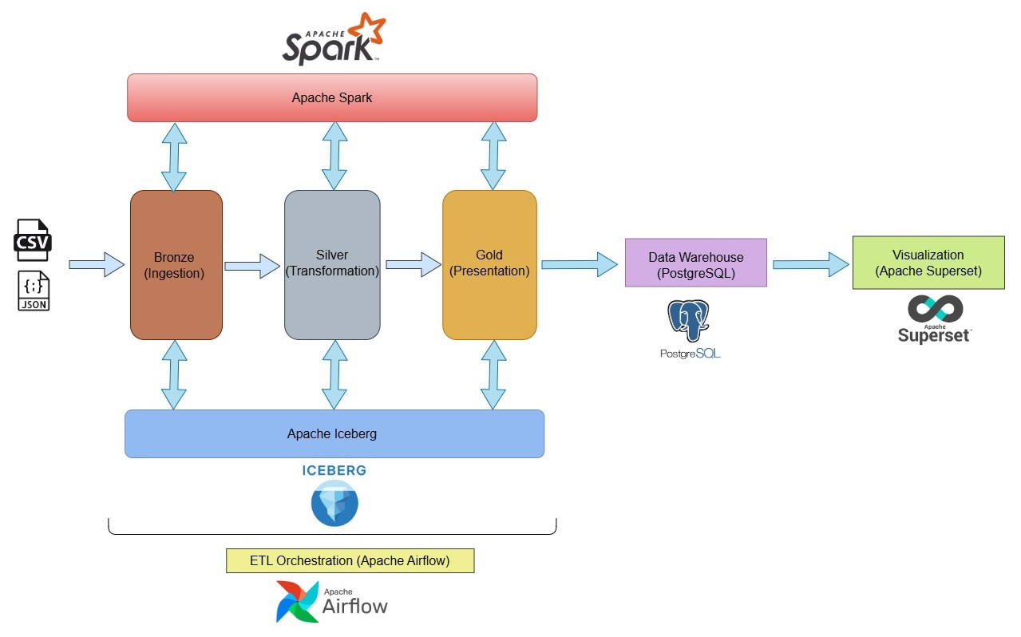
Solution Architecture
1

Slide 5
Tools used for Development
🧊 Apache Iceberg (Data Storage) Why: Provides a scalable, ACID-compliant table format ideal for large-scale analytics. It ensures data versioning, time travel, and schema evolution—all important for healthcare data integrity. | 🏛️ PostgreSQL (Data Warehouse) Stores the final, processed (Gold Layer) data in a structured format that's easy to query for dashboard tools. It supports complex joins and analytics.
⚡ Apache Spark (Data Processing) Handles distributed data processing efficiently. It’s ideal for cleaning, transforming, and aggregating large CSV/JSON healthcare datasets into Parquet format. | 📊 Apache Superset (Visualization) Creates interactive dashboards that provide cost insights, risk analysis, and trends, helping stakeholders and patients make data-driven decisions.
🪂 Apache Airflow (Workflow Orchestration) Automates the end-to-end workflow—from ingestion to transformation to reporting—through DAGs (Directed Acyclic Graphs), reducing manual intervention and improving reliability.
1

Slide 6
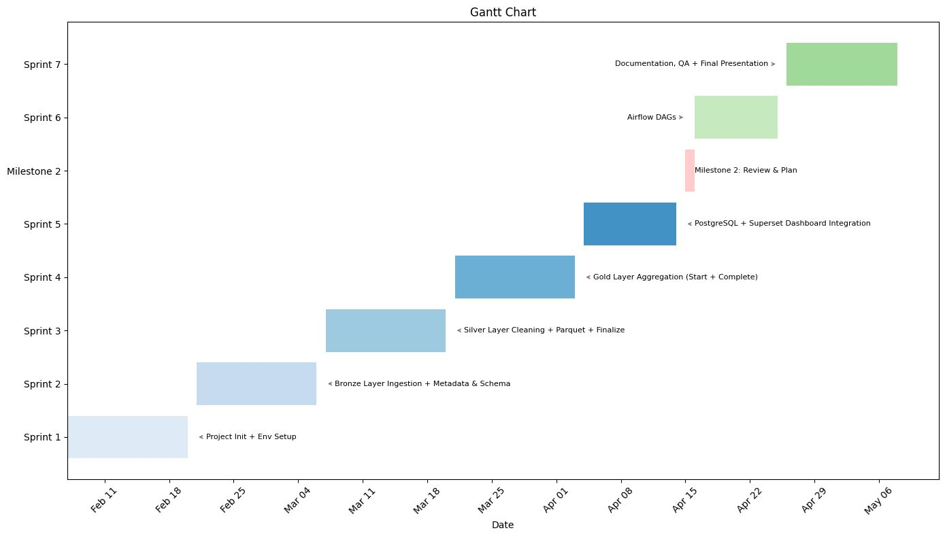
Roadmap
1

Slide 7
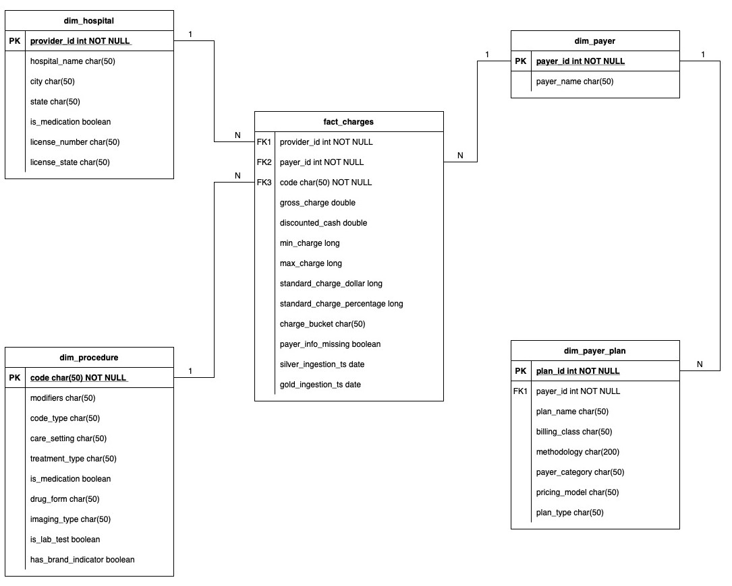
Entity Relationship Diagram (ERD)
1

Slide 8
Future Extension
Workflow Automation: Implement Apache Airflow to orchestrate and automate data pipeline tasks for enhanced efficiency and reliability.
Standardized Framework: Establish a unified workflow and standardization process to ensure consistency across the entire pipeline.
Documentation Creation: Develop clear and concise project documentation to outline the architecture, workflow, and implementation details.
1

Slide 9
Demonstration of the project Video
1

Slide 10
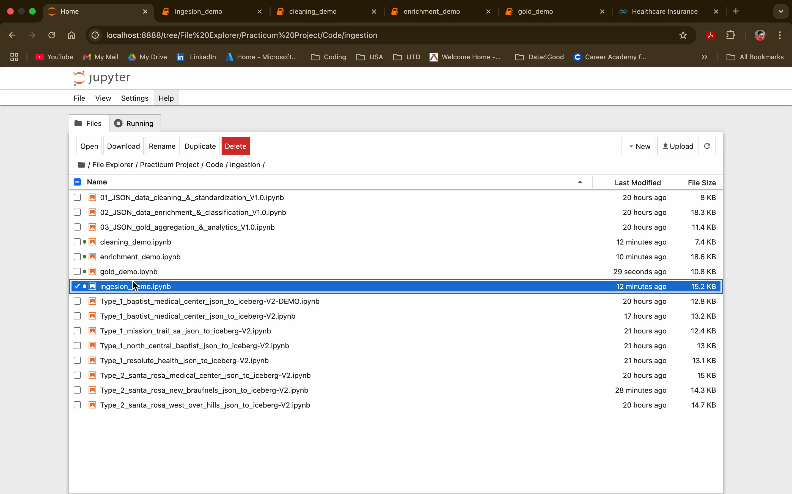

Slide 11
THANK YOU

